Slide 1
Weather Forecast
Submitted By:
Shubham Solanki
A2345916008
B.TECH 5-CSE EVNG.
Submitted To:
Mr.Raj Kumar Sagar

Slide 2
INTRODUCTION
Websites are made up of two end that are front end and back end .
Front end comprises the looks and user experience about how the things will be perceived by the user and it is visible by the user and this front end work by the developer gives a good impression to the user and it is pleasing for him because the looks are the priority in any kind of website .
The number of users tend to increase if a website has interactive front end work and its interface is beautiful and appealing.
Back end comprises all the work behind the front end that is all the machinery work that comes into the play while developing a website. It is very mandatory for a developer for creating a back end work to make sure that website is working with Excellency and superiority.
Front end tends to please the users but back end tends to satisfy the user.

Slide 3

BACK END – FRONT END

Slide 4
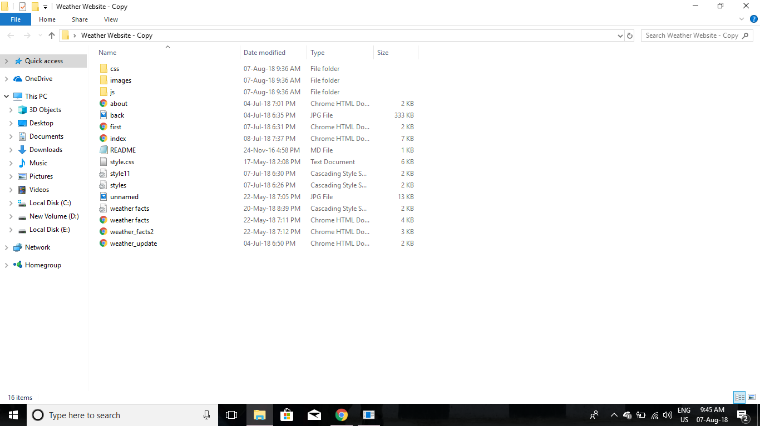
Files Used in the Project

Slide 5
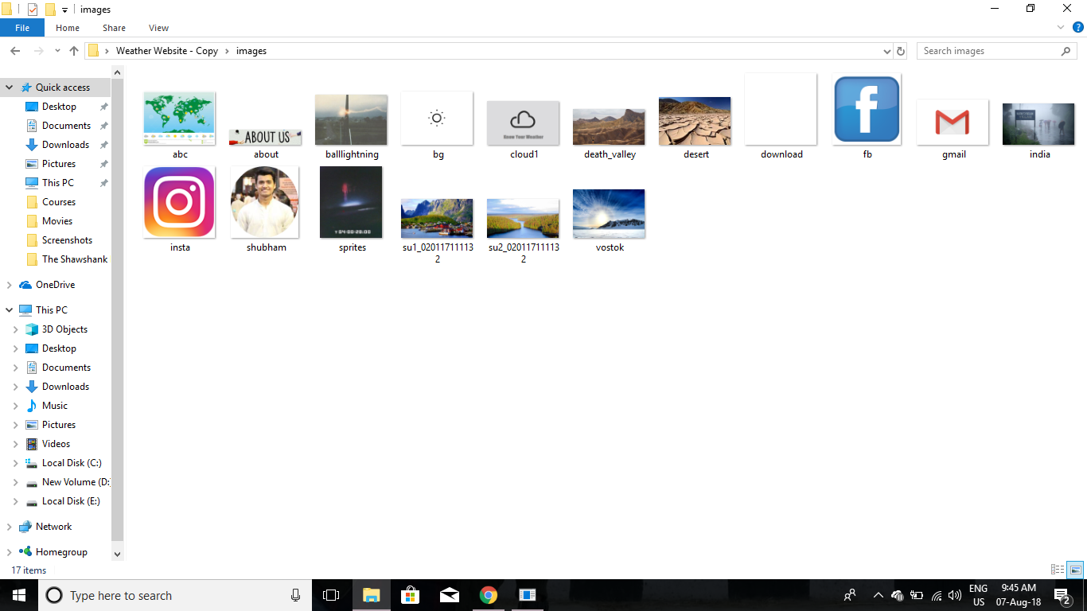

Slide 6
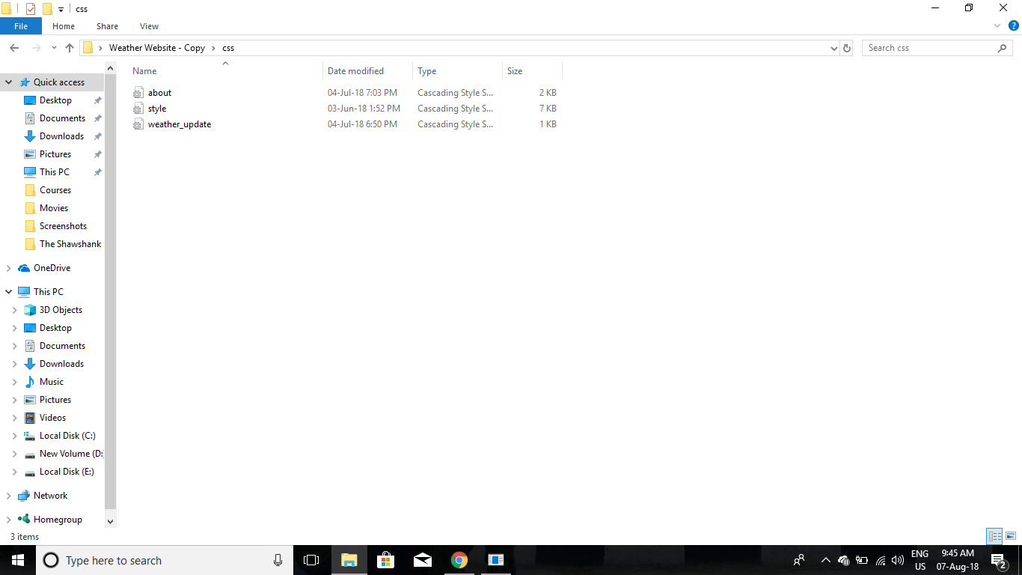

Slide 7
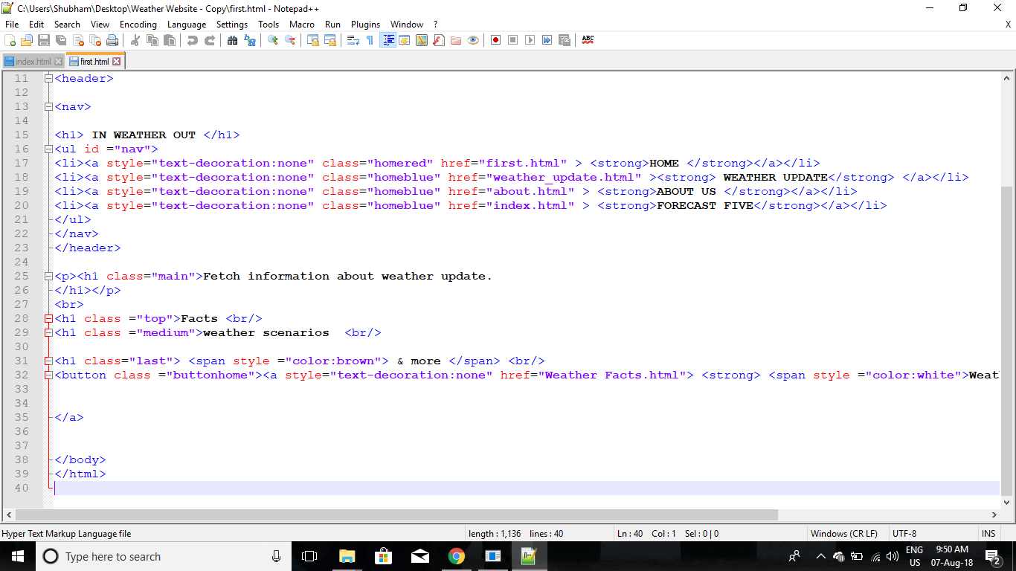
Front end Coding

Slide 8
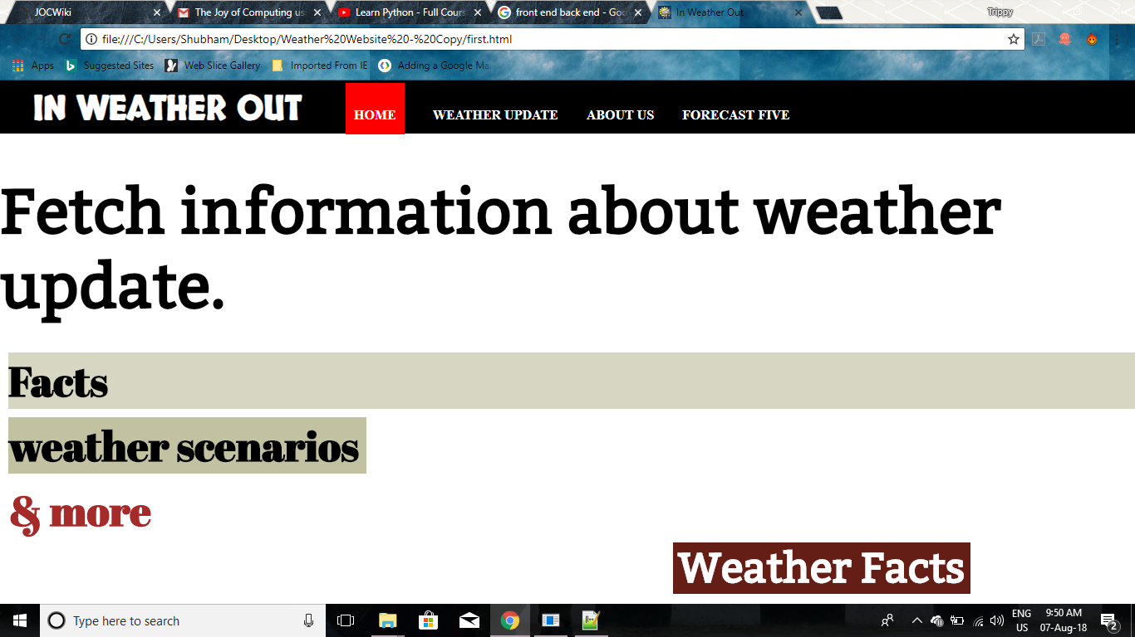
Design

Slide 9
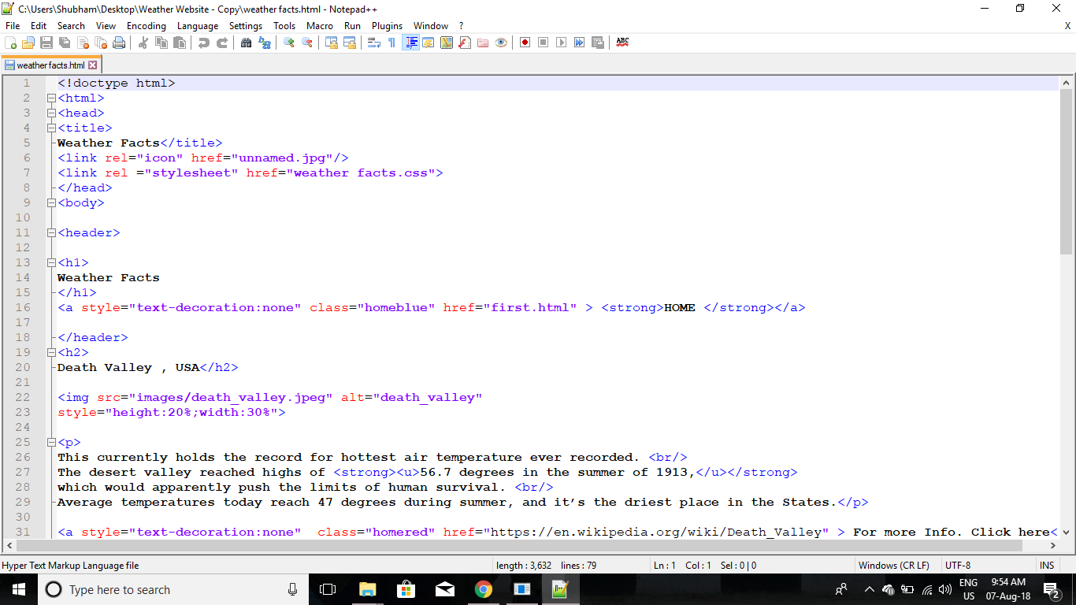
Code

Slide 10
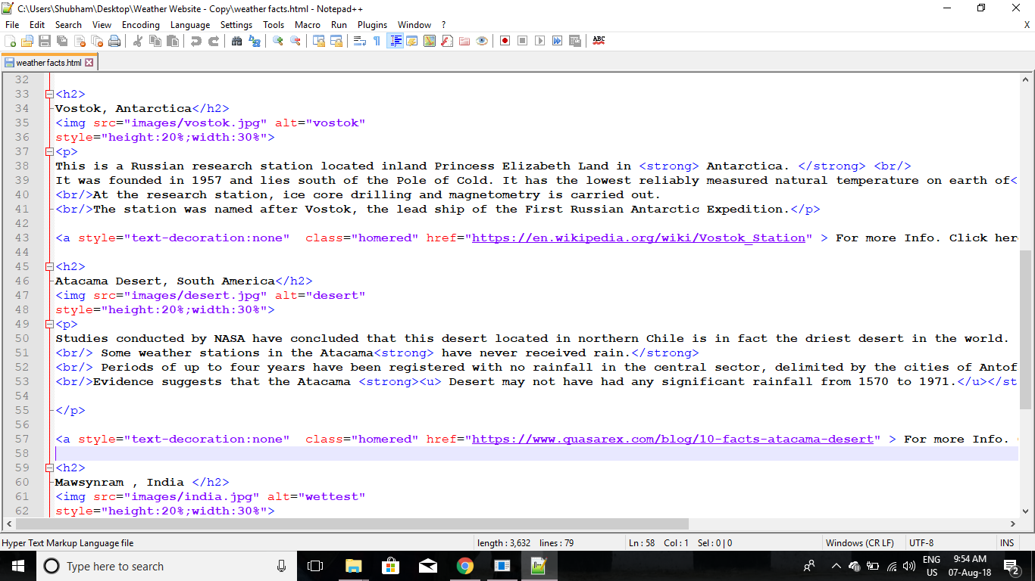

Slide 11
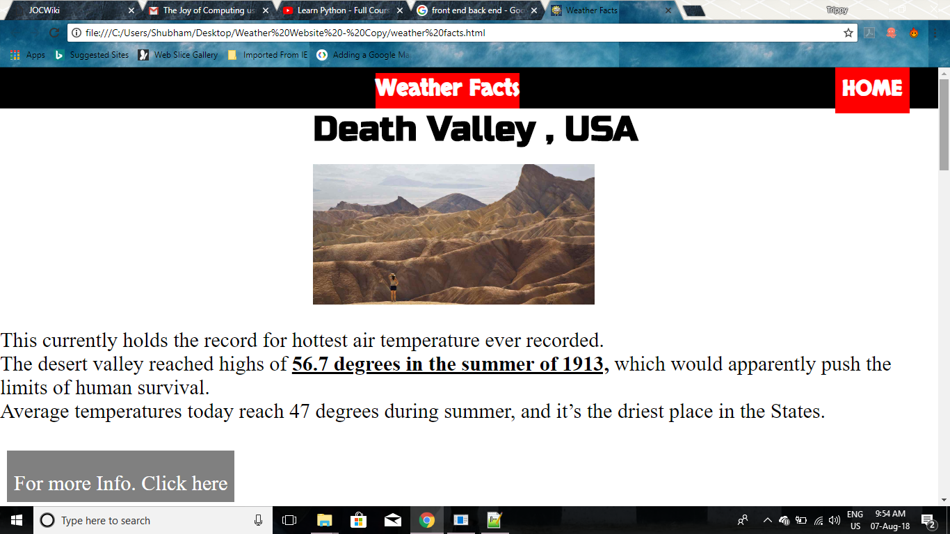
Output

Slide 12
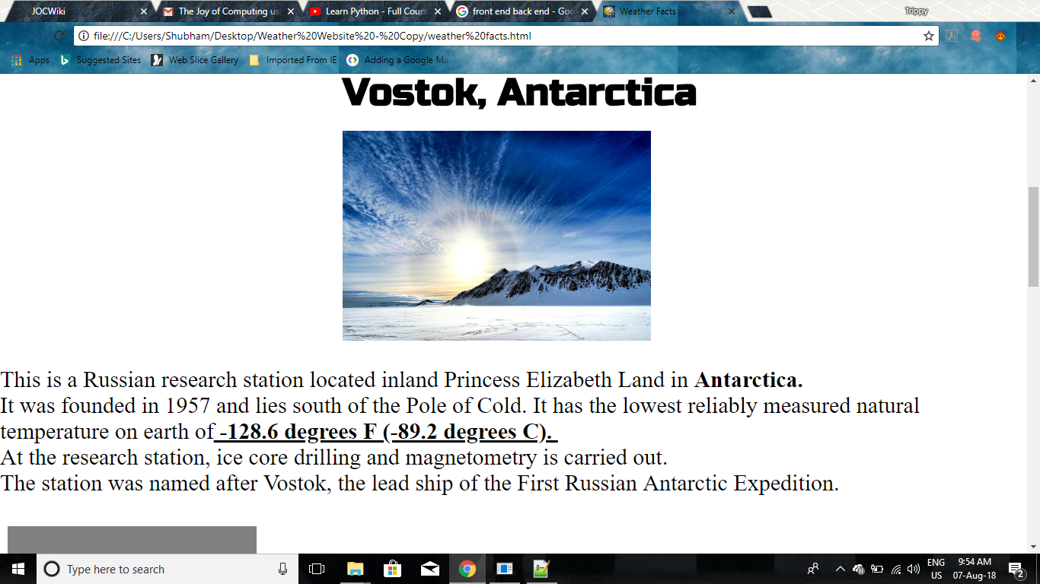

Slide 13
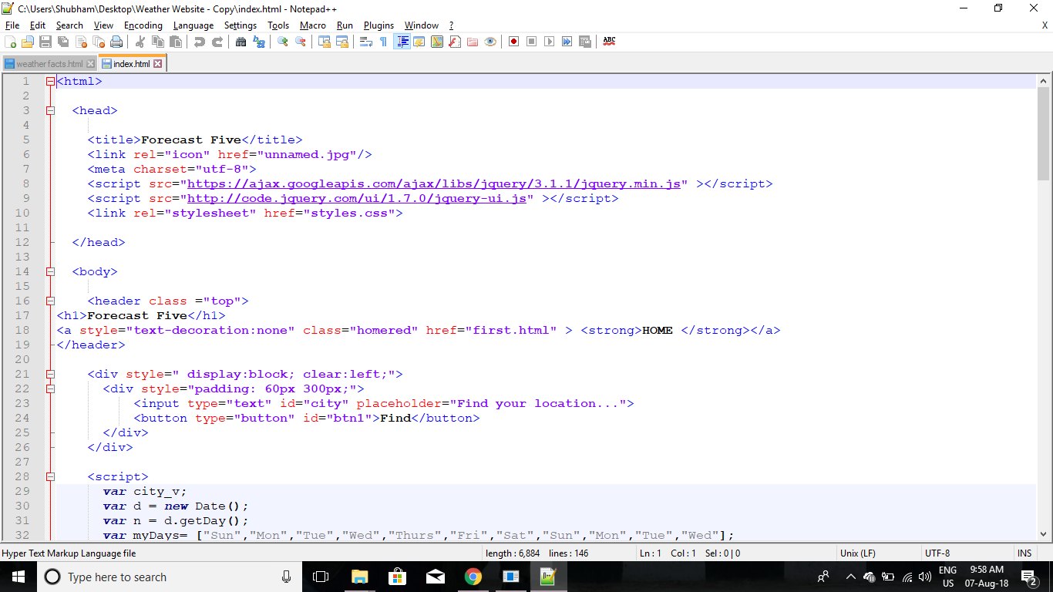
Back-End Coding

Slide 14
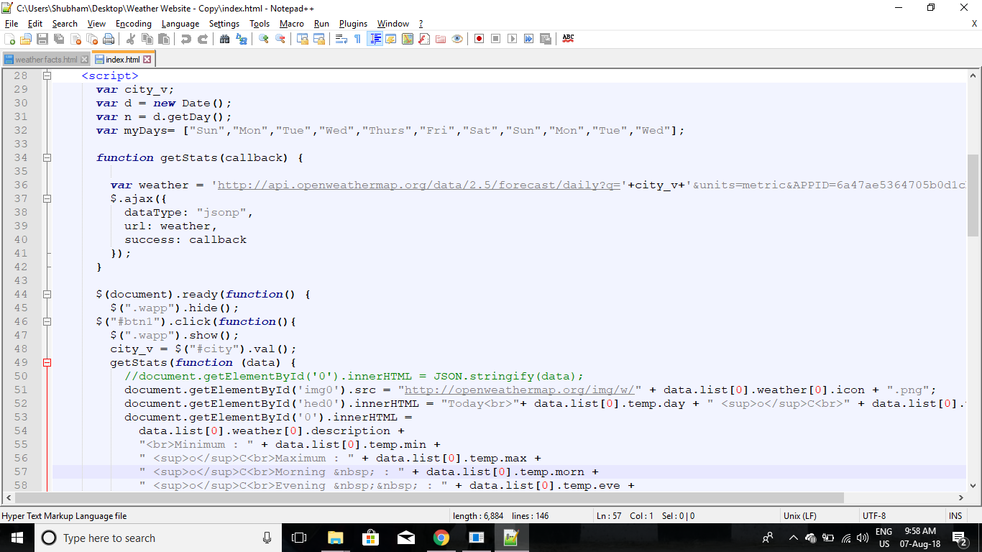

Slide 15
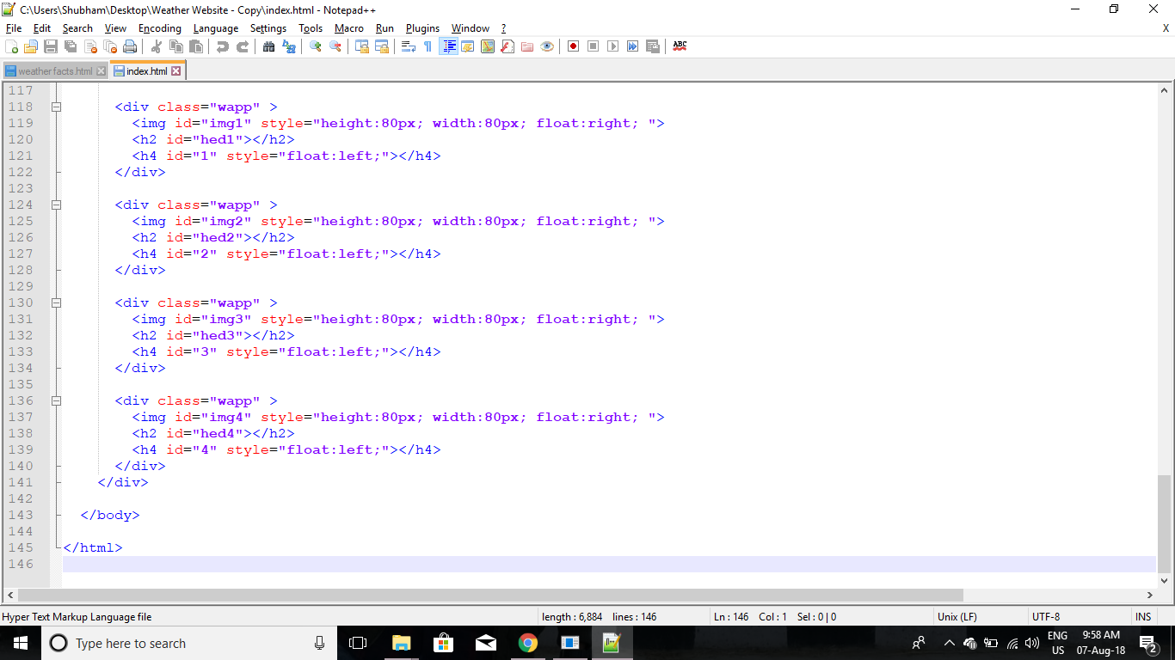

Slide 17
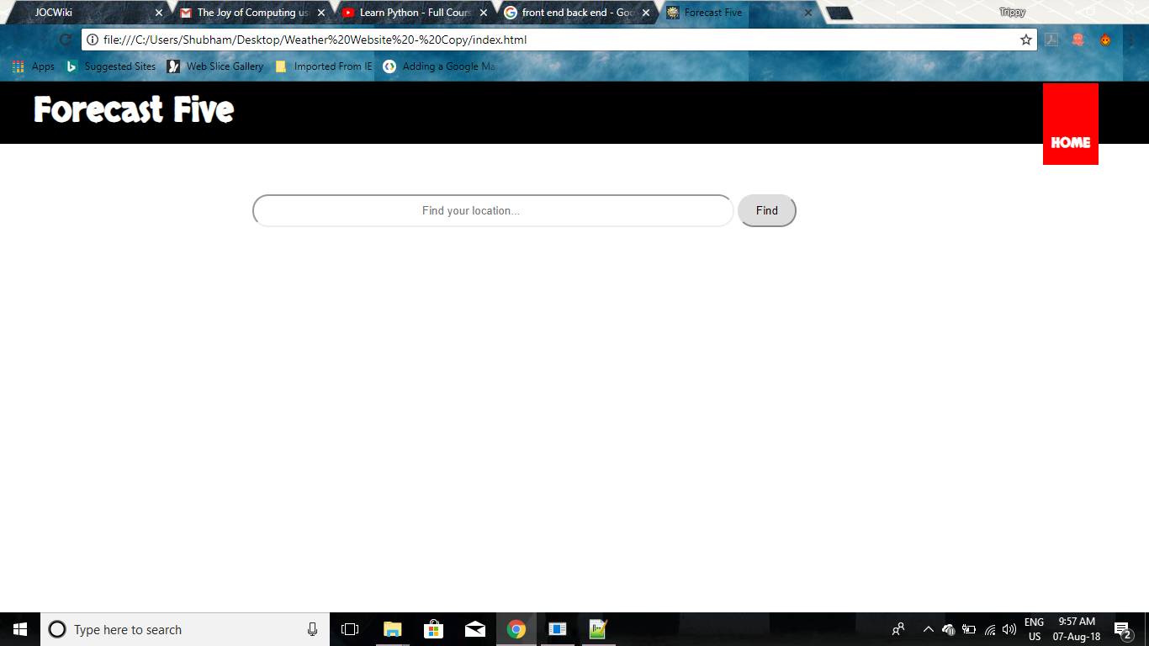
Output

Slide 18
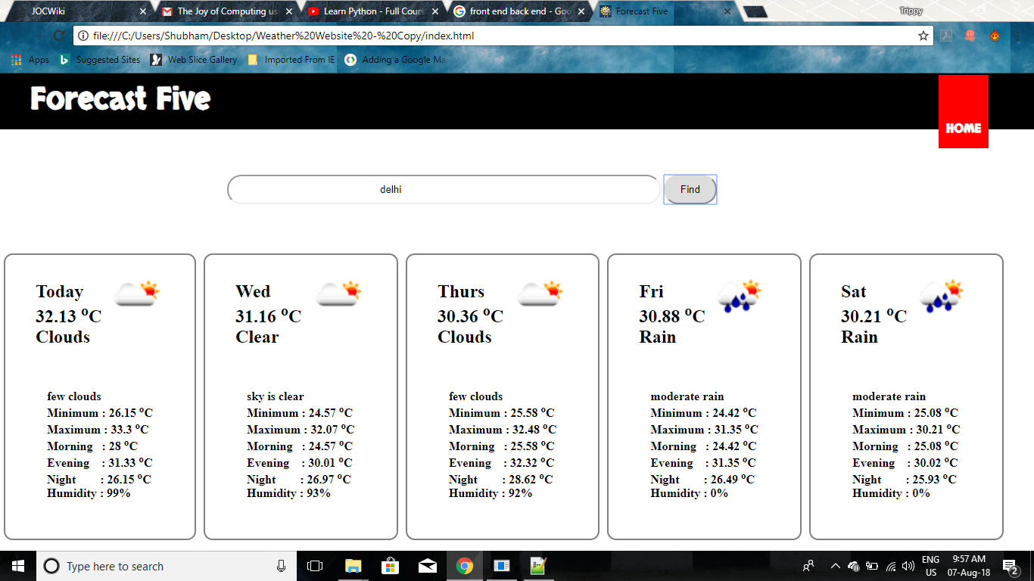

Slide 19
Conclusion
After doing this composition I will assure that I’ve gained an honest data regarding the Web-developement.
• This composition helps to enhance a person’s ability to try to to one thing that's out of the box and really distinctive.
• By doing this composition, Students gains ability to try to to one thing in future concerning the subject he/she has taken within the composition.
• In this composition I learnt regarding the styles of CSS, their design and lots of additional.
• I’ve learnt about the back end language used here in the project that is Java Script.
• By doing this project I have learnt a good amount of knowledge about structural languages like HTML and CSS.
• With due regards this composition will increase a person’s capability and performance for doing one thing productive and effective for the technical reasons.

